Slide 1

Title
EC18811 PROJECT WORK VIVA VOCE EXAMINATION
IMAGE PROCESSING BASED ANIMAL INTRUSION DETECTION SYSTEM IN AGRICULTURAL FIELDS USING DEEP LEARNING
SUPERVISOR
MS. K. SRIVIDHYA
Assistant Professor
Department of ECE
Members of students:
G. OVIYA (Reg. No.: 190701071)
D. PRAPTI (Reg. No.: 190701078)

Slide 2
Introduction
Agriculture is one of the most critical sectors for any economy as it contributes significantly to the food supply chain.
In this project, we compare the performance of two deep learning models, YOLOv7 and Faster RCNN, for animal intrusion detection in agricultural fields.
The You Only Look Once (YOLOv7) model is a state-of-the-art object detection model that has been shown to achieve high accuracy and fast processing speeds.
The Faster RCNN model, on the other hand, is a widely used object detection model that has been around for a while and is known for its high accuracy. Our aim is to determine which model is more suitable for the specific requirements of the animal intrusion detection system in agricultural fields.
The proposed animal intrusion detection system can help farmers mitigate crop damage and reduce losses by providing real-time alerts indicating the type and location of animals that have entered the field.

Slide 3
Objective
To develop a robust and accurate deep learning model using YOLO V7 and Faster RCNN that can detect and classify animal intrusions in agricultural fields using Raspberry Pi in order to prevent crop damage and animal-deaths due to electrocution from illegal power fence.
To train the deep learning model on a large dataset of animal images to improve its accuracy and generalization ability.
To optimize the model's hyperparameters, such as learning rate, batch size, and regularization, to achieve the best performance on the test dataset.
To deploy the trained model on cameras placed in the agricultural fields to detect and classify animal intrusions in real-time.
To generate alerts whenever an animal intrusion is detected using Raspberry Pi, allowing farmers or operators to take necessary actions to protect their crops from further damage.

Slide 4
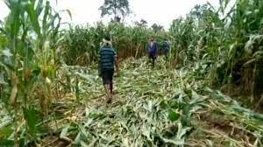
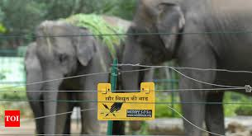
Proposed Model
Agricultural fields face several challenges, including animal intrusion, which can result in significant crop damage and loss. Traditional methods of animal control, such as fencing and scarecrows, can be ineffective and time-consuming. This project proposes an image processing based animal intrusion detection system using Raspberry Pi model in agricultural fields by using deep learning algorithms such as YOLOv7 and Faster RCNN models.

Slide 5
Proposed Model
The system utilizes a webcam to capture live video feed of the agricultural fields, detects and analyzes the intrusion using Raspberry Pi and deep learning models. If an intrusion is detected, the system produces repellent sounds with help of speakers and also sends an alert to farmers via GSM.
This system provides an efficient and effective solution for preventing crop damage and reducing human-wildlife conflict in agricultural fields.

Slide 6
Literature Survey
S.NO | TITLE/YEAR PUBLISHED | PROPOSED WORK | ADVANTAGES | LIMITATIONS
1. | N. Mamat, M. F. Othman and F. Yakub, "Animal Intrusion Detection in Farming Area using YOLOv5 Approach," 2022 22nd International Conference on Control, Automation and Systems (ICCAS), Jeju, Korea, Republic of, 2022, pp. 1-5, doi: 10.23919/ICCAS55662.2022.10003780. | This paper proposes the use of the YOLOv5 algorithm for real-time animal detection in precision agriculture. The authors used a dataset consisting of cows, buffaloes, and horses, and the YOLOv5 algorithm achieved high accuracy in detecting animals. | The proposed approach is efficient, as it does not require extensive preprocessing of the data before detection. | Usage of limited dataset for the experiments, which may not be representative of all types of animal intrusions that farmers may encounter.

Slide 7
Literature Survey
S.NO | TITLE/YEAR PUBLISHED | PROPOSED WORK | ADVANTAGES | LIMITATIONS
2. | N. L. Vidya, M. Meghana, P. Ravi and N. Kumar, "Virtual Fencing using Yolo Framework in Agriculture Field," 2021 Third International Conference on Intelligent Communication Technologies and Virtual Mobile Networks (ICICV), Tirunelveli, India, 2021, pp. 441-446, doi: 10.1109/ICICV50876.2021.9388585. | The proposed solution in the paper by N. L. Vidya et al. provides an innovative approach to livestock management in agriculture fields using a combination of YOLO and GPS technology. The use of YOLO for object detection and GPS for virtual fencing has the potential to reduce the cost and maintenance required for physical fencing, and improve the overall efficiency of livestock management in agriculture. | The proposed solution is scalable and can be used for large agricultural Fields. | The study does not provide information about the accuracy of the virtual fencing system and its effectiveness in preventing livestock from entering restricted areas.
Literature Survey Literature Survey

Slide 8
Literature Survey
S.NO | TITLE/YEAR PUBLISHED | PROPOSED WORK | ADVANTAGES | LIMITATIONS
3. | B. K. Reddy, S. Bano, G. G. Reddy, R. Kommineni and P. Y. Reddy, "Convolutional Network based Animal Recognition using YOLO and Darknet," 2021 6th International Conference on Inventive Computation Technologies (ICICT), Coimbatore, India, 2021, pp. 1198-1203, doi: 10.1109/ICICT50816.2021.9358620. | The proposed system in this paper builds on these previous studies by combining a CNN with the YOLO object detection framework and utilizing the Darknet framework for fast and efficient training. The experimental results presented in the paper demonstrate the potential of the proposed system for practical applications in wildlife monitoring and conservation. | The use of the Darknet framework allows for fast and efficient training of the CNN model, which is important for real-time application. | The study does not provide information on the computational resources required for training and running the CNN model, which could be a limiting factor for implementation in low-resource settings.

Slide 9
Literature Survey
S.NO | TITLE/YEAR PUBLISHED | PROPOSED WORK | ADVANTAGES | LIMITATIONS
4. | Balakrishna, K., Mohammed, F., Ullas, C., Hema, C., & Sonakshi, S. (2021). Application of IOT and machine learning in crop protection against animal intrusion. Global Transitions Proceedings, 2(2), 169-174. https://doi.org/10.1016/j.gltp.2021.08.061 | The proposed a model that uses IoT and machine learning to address this problem. The model consists of wireless sensor nodes placed in the farm, which detect the presence of animals and send the data to a central processing unit. The data is then analyzed using machine learning algorithms to identify the type of animal and its behavior. Based on this analysis, the model triggers an appropriate action, such as sounding an alarm or activating a scarecrow, to deter the animal. | The use of IoT and machine learning to solve this problem is a novel approach, and the paper provides detailed information on the implementation of this technology. | The sample size used in the study is not clearly stated, which may affect the generalizability of the results also this paper does not include a discussion on the limitations and future directions of the study, which would have added to its overall value.

Slide 10
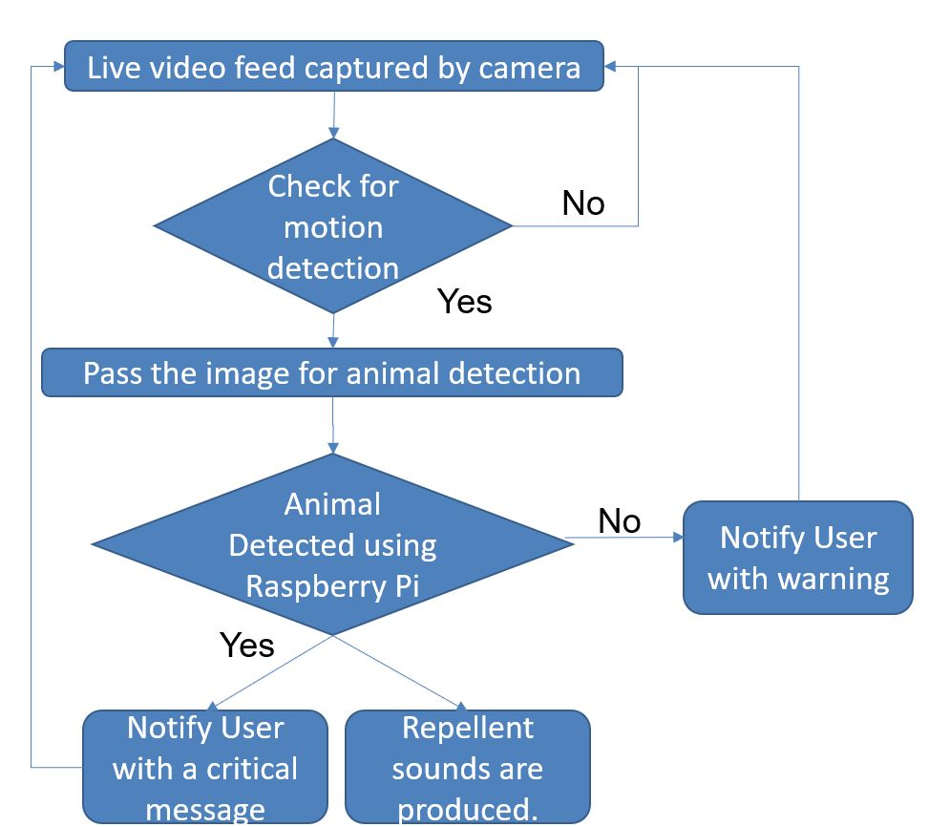
Workflow

Slide 11
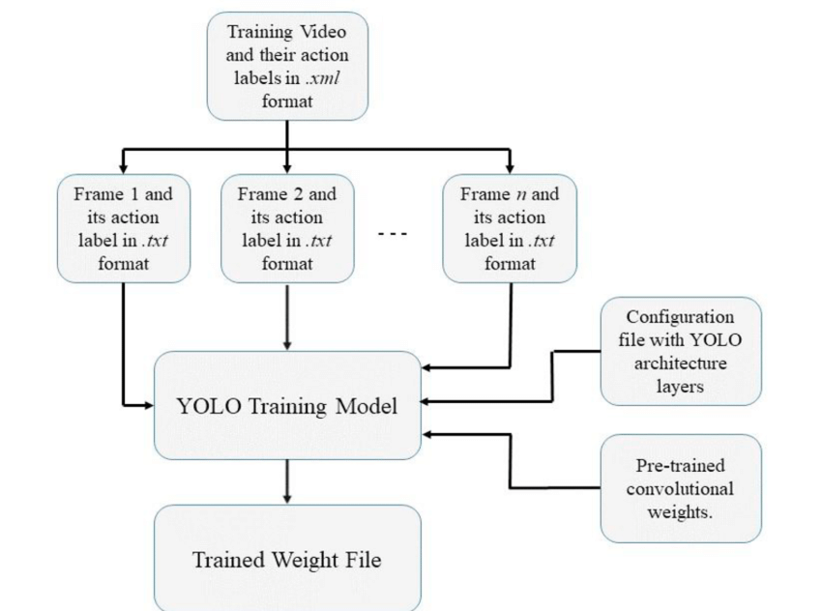
YOLOv7 Model-Flowchart

Slide 12
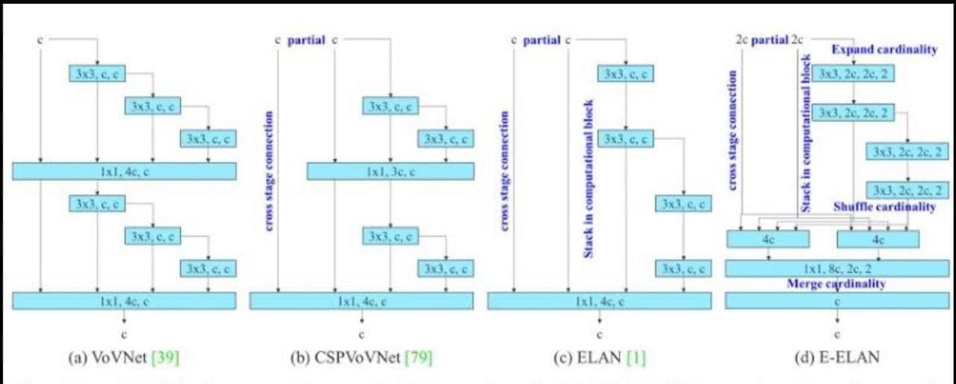
YOLOv7 Feature extraction
Earlier Resnet was used but now dense net is used in order to reduce the vanishing gradient.
ELAN is used in order to increase the parameters and it is made wider for more accuracy.

Slide 13
YOLOv7 Feature extraction
In YOLOv7 Extended ELAN is used using 3 components which are wider and that enables higher computation rate and accuracy.
Model scaling is another unique feature introduced in yolov7 which needs high inference speed and accuracy.
It is a concatenation based model in which width and heights are interrelated.
Model optimization was done to increase the speed of the model by the following techniques;
Model level
2. Module level

Slide 14
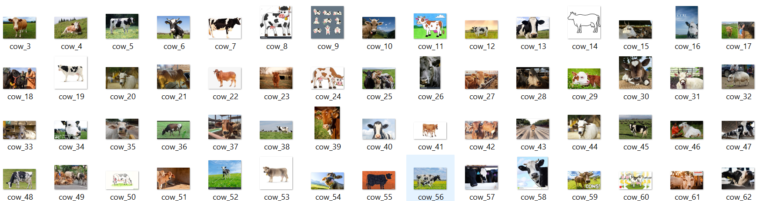
Training Model
Collection of Data:
To create data, animal photographs must first be gathered. We gathered pictures of eight different animal species: dogs, cats, horse, sheep, elephant, bear, cow and bird. We gathered at least 500 pictures of a single animal class to make a training module. So, in total, we gathered about 4000 pictures. For the picture testing, we gathered unique photographs for each class

Slide 15
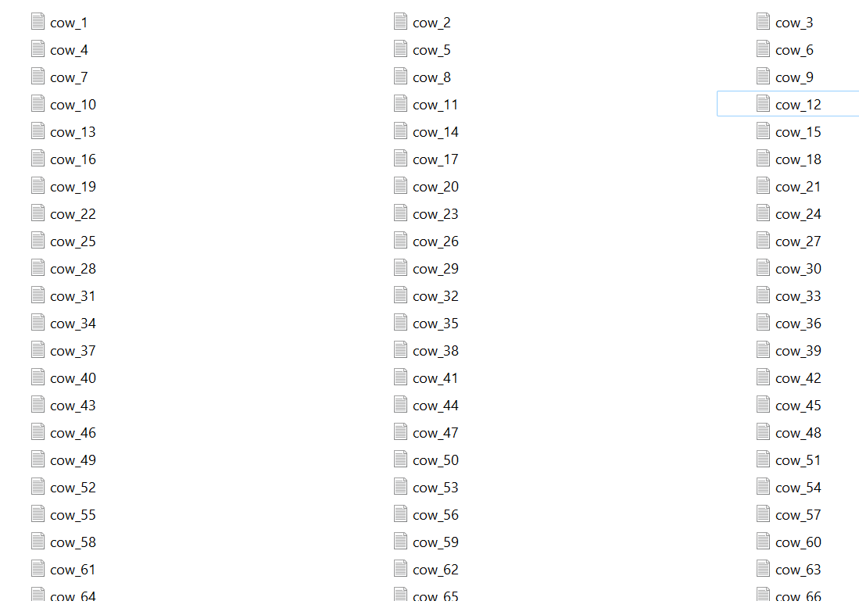
Training Model
Image Labeling:
Data must be tagged after collection in order to produce a text document that can be used to develop a training module. The images are first accessed, and if it contains the animal classes we need, it is then picked using a bounding box. The class of animals defined after the animal is enclosed by a box, as seen in the following figure:

Slide 16
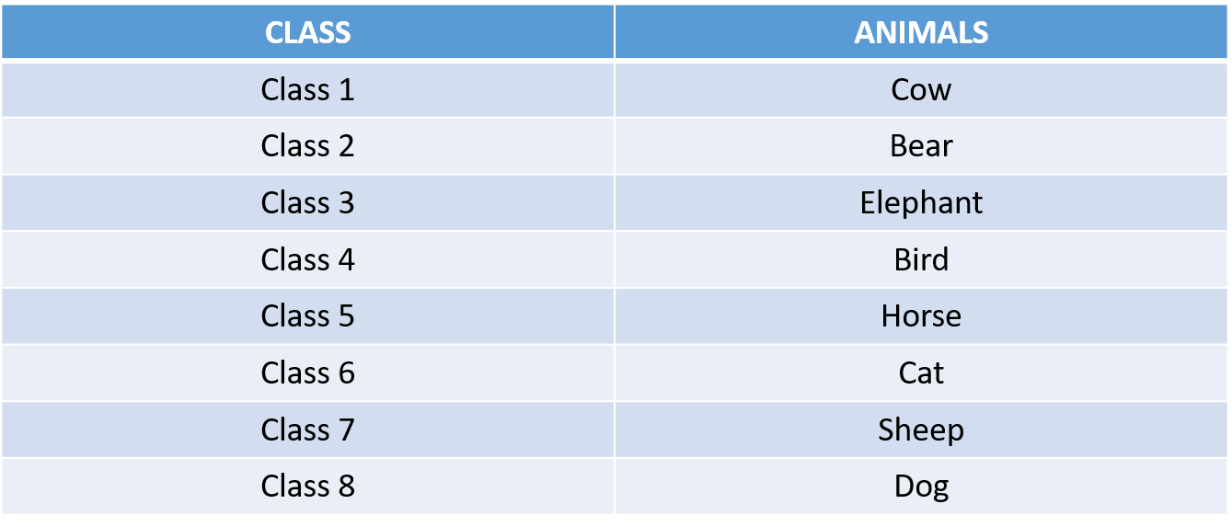
Training Model
To label images we used labeling. This tool can detect animal for YOLOv7 and other as well. We can find more than one data in a single image. So, in 4000 images we collected more than 4000 data. In labeling we have to classified animal from class 1 to class 8. So we classified animals as:

Slide 17
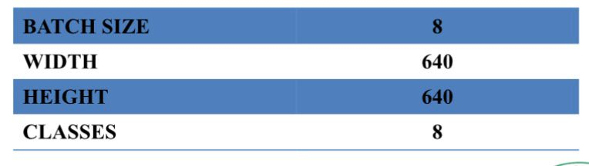
Training Model
Here No. of epochs = 100 .
Training Data :
Images : 3000
Labels : 3000
Where, epochs is a hyperparameter that defines the number times that the learning algorithm will work through the entire training dataset and N is number of classes.
As we have to train 8 classes of animals, we have to use 100 epochs.

Slide 18
Hardware and Software requirements
SOFTWARE COMPONENTS
Python – 3.9
Visual studio code
OBS studio
HARDWARE COMPONENTS
Raspberry pi 4 model B
Webcam
Speakers

Slide 19
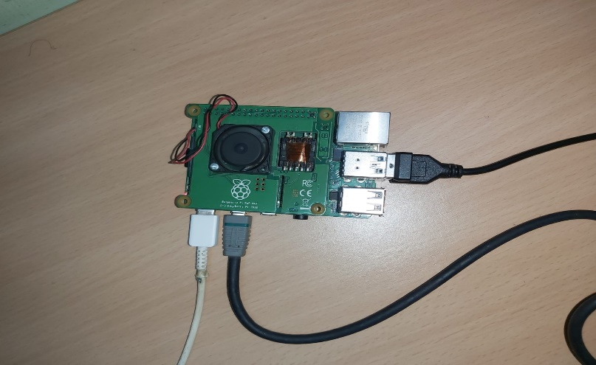
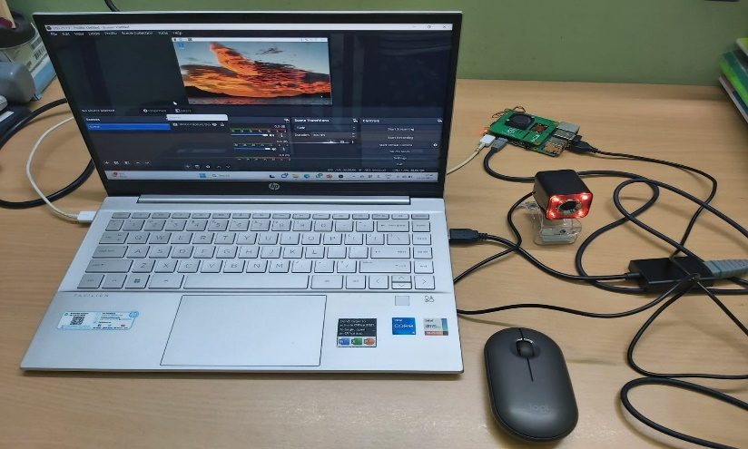
Raspberry Pi
The webcam and video converter is connected to raspberry pi. The Raspberry pi is externally powered and connected to mouse and keyboard for the purpose of accessing the device.

Slide 20
Block Diagram
Raspberry Pi
Repellent sound
Camera
Image Processing
SMS notification

Slide 21
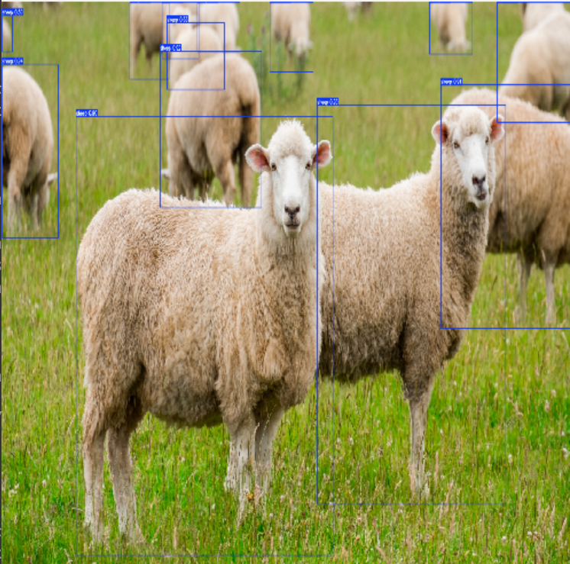
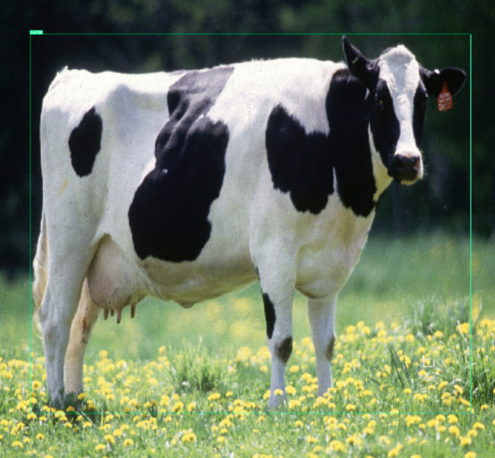
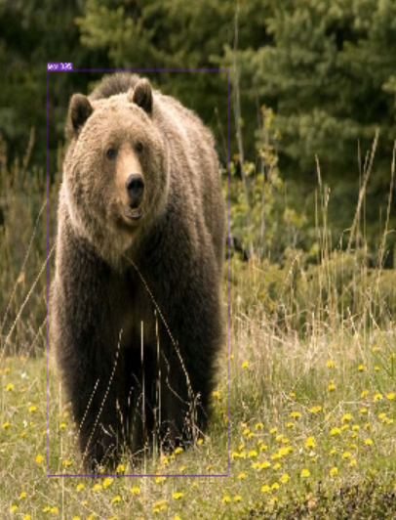
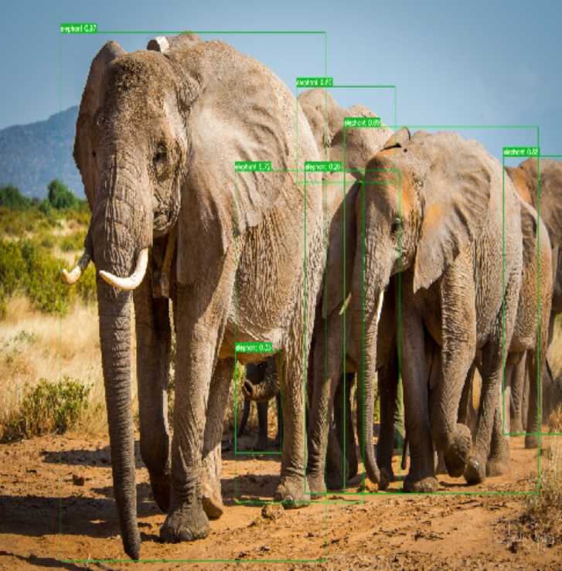
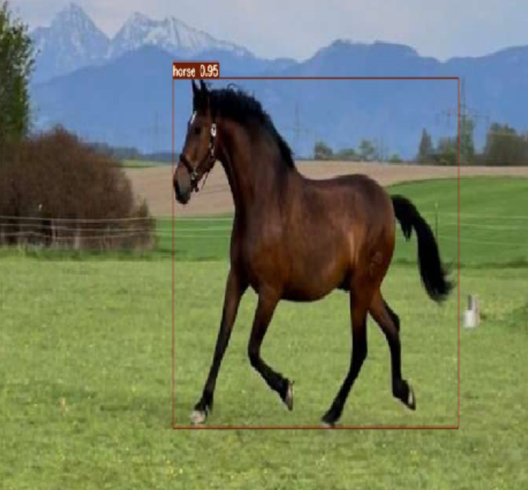
YOLOv7 Result
90%
94%
96%
97%
95%

Slide 22
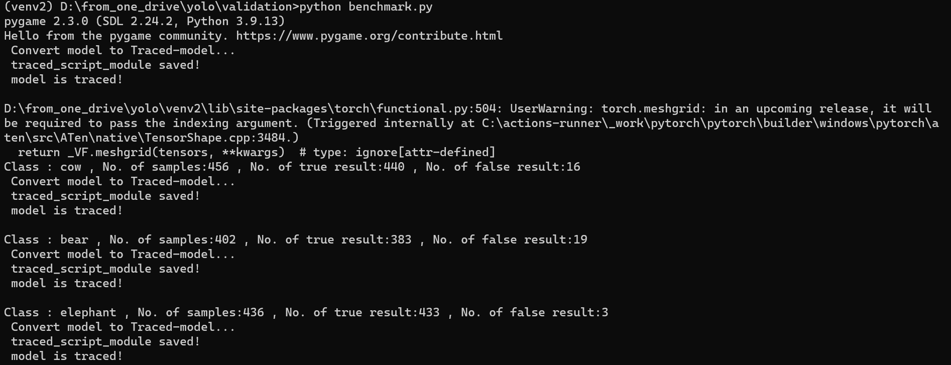
Result
YOLOv7 model output:

Slide 23
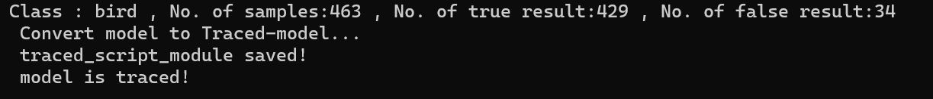
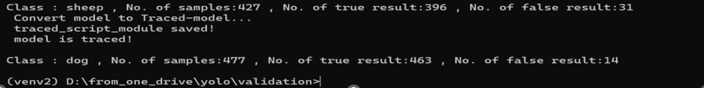
Result

Slide 24
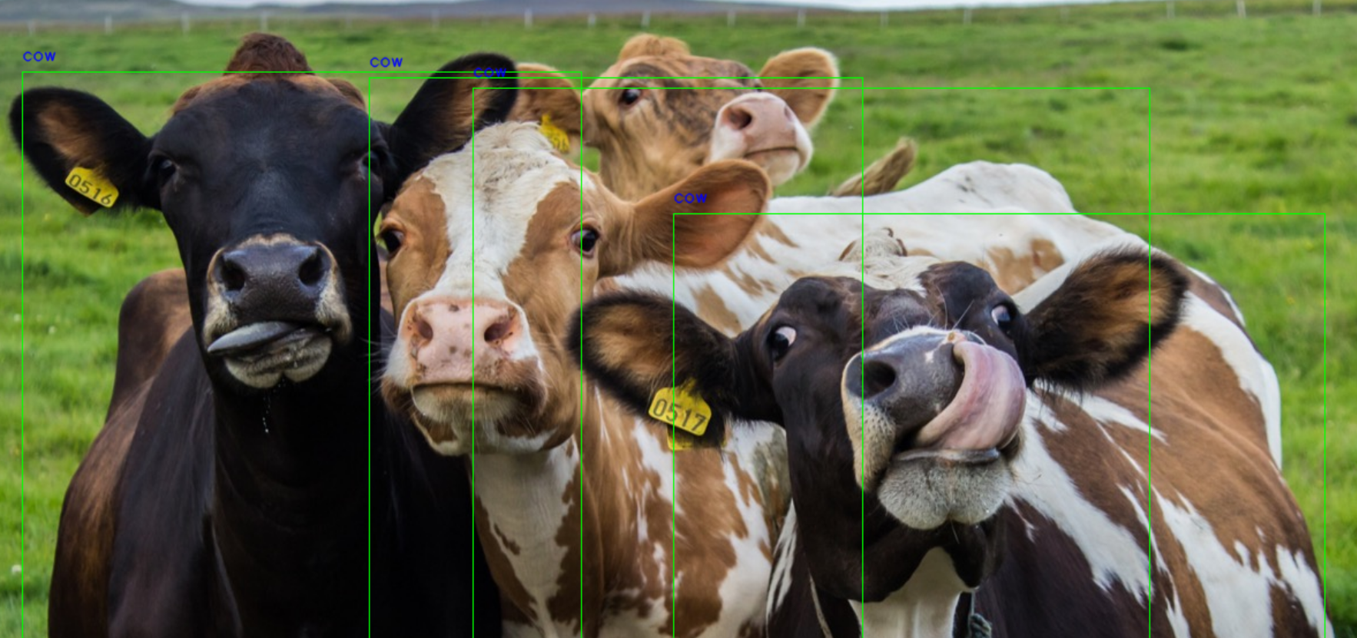
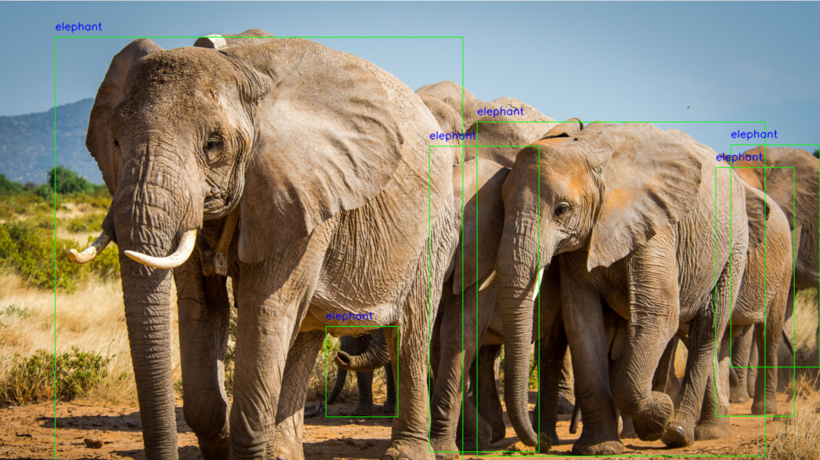
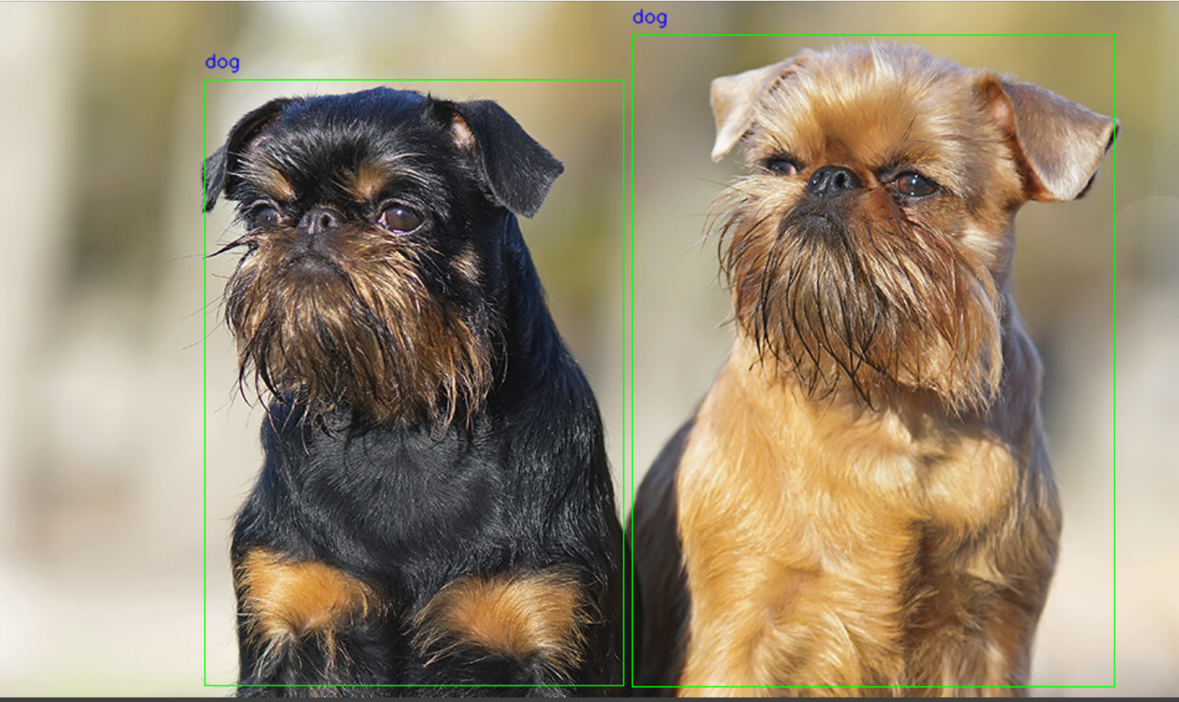
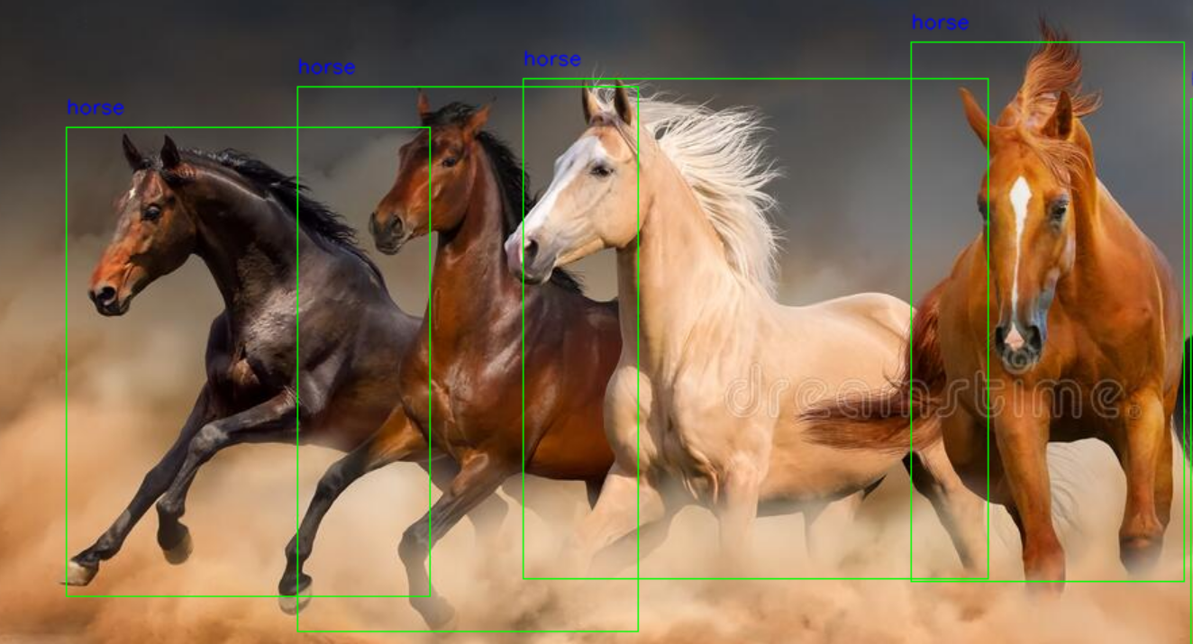
Faster RCNN Result

Slide 25
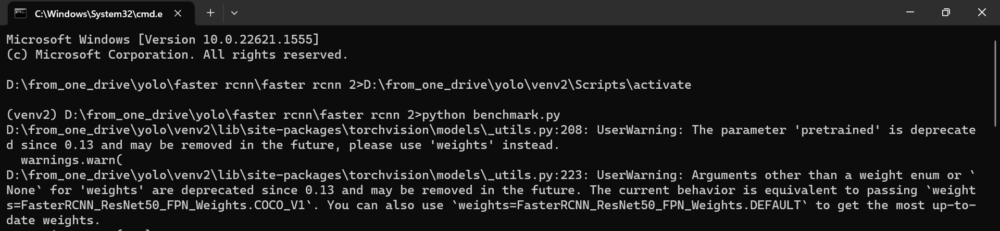
Result
Faster RCNN model output:
Result

Slide 26
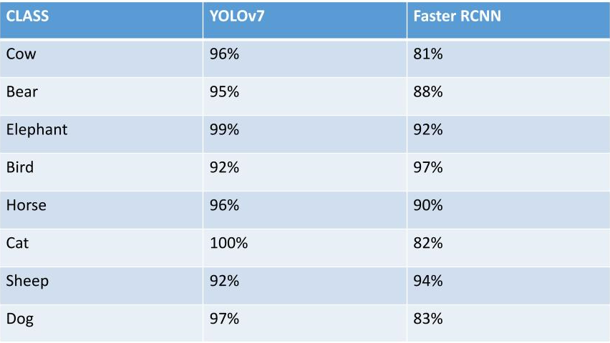
Result
Comparing accuracy for 8 classes:
From the above table we can conclude that YOLOv7 model is highly efficient in terms of accuracy as compared to Faster RCNN model.

Slide 27
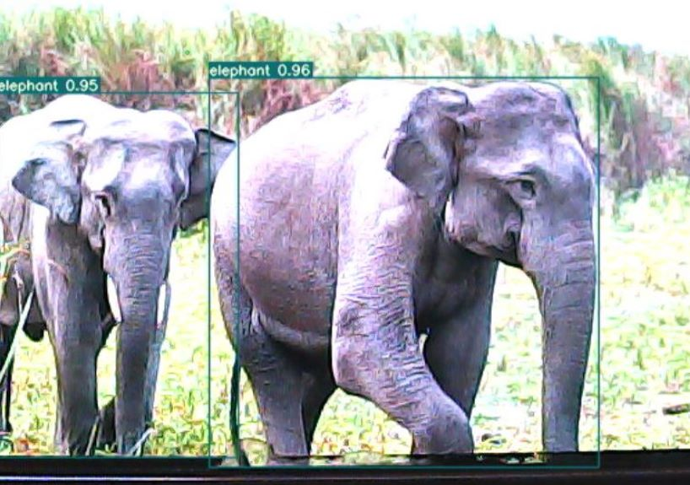
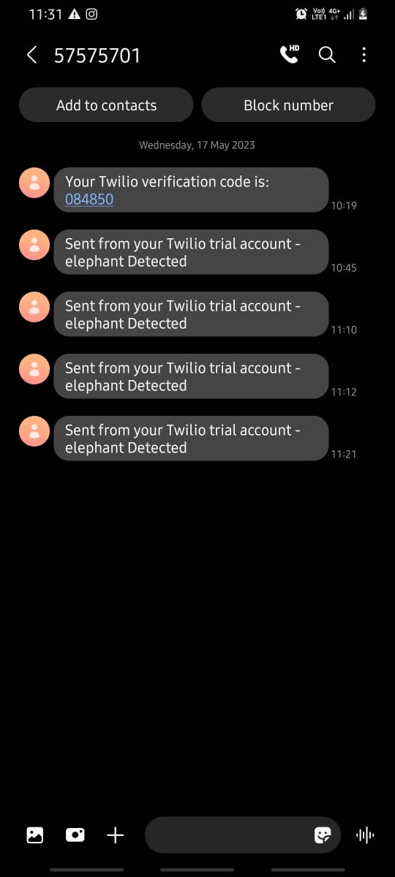
Result
Detecting the movement of animal in live video feed and generating alert.

Slide 28
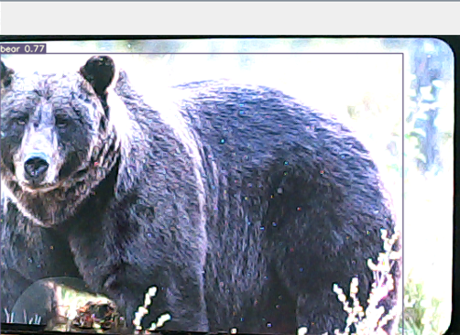
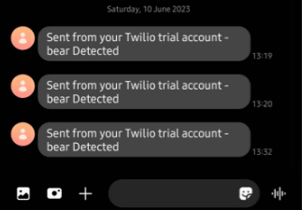
Result
Detecting the movement of animal in live video feed and generating alert.

Slide 29
Advantages
Early Detection: The system can detect intruding animals in real-time, allowing farmers to take immediate action to prevent damage to their crops. Early detection can also prevent harm to both the animals and the farmers.
Accuracy: Image processing algorithms using deep learning can accurately identify animals in images, even in low-light or adverse weather conditions, which can improve the accuracy of the detection system.
Cost-Effective: The use of cameras and image processing software can be more cost-effective compared to traditional methods, such as hiring security personnel or using physical barriers.
Non-Invasive: The system is non-invasive and does not require any physical interaction with the animals. It can detect the presence of animals without disturbing their natural behavior.
Scalability: The system can be scaled up or down depending on the size of the agricultural field. The number of cameras and the processing power required can be adjusted accordingly.
Automated Alerts: The system can automatically generate alerts when animals are detected, allowing farmers to respond quickly and efficiently.

Slide 30
Application
It helps in preventing crop damage and animal-deaths due to electrocution from illegal power fence.
The use of the intrusion detection system helps the government to maintain border security and prevent illegal crossings, which can pose a threat to national security.
The use of the intrusion detection system helps the company to maintain high-security measures and protect sensitive information and assets. The system saves time and money that would have been spent on hiring additional security personnel to monitor entry points.

Slide 31
Action Plan
REVIEW 1:
Collection of Data sets, labelling the images, training the ML model and validating the generated model with YOLO V7.
REVIEW 2:
Training and validation using Fast RCNN approach. Creating a python script and detecting the movement of object in live video feed.
REVIEW 3:
Processing it in the ML model and detecting the animal and notifying the farmer using GSM and generating specific repellent sounds for specific animals.

Slide 32
References
[1]. N. Mamat, M. F. Othman and F. Yakub, "Animal Intrusion Detection in Farming Area using YOLOv5 Approach," 2022 22nd International Conference on Control, Automation and Systems (ICCAS), Jeju, Korea, Republic of, 2022, pp. 1-5, doi: 10.23919/ICCAS55662.2022.10003780.
[2]. N. L. Vidya, M. Meghana, P. Ravi and N. Kumar, "Virtual Fencing using Yolo Framework in Agriculture Field," 2021 Third International Conference on Intelligent Communication Technologies and Virtual Mobile Networks (ICICV), Tirunelveli, India, 2021, pp. 441-446, doi: 10.1109/ICICV50876.2021.9388585.
[3]. B. K. Reddy, S. Bano, G. G. Reddy, R. Kommineni and P. Y. Reddy, "Convolutional Network based Animal Recognition using YOLO and Darknet," 2021 6th International Conference on Inventive Computation Technologies (ICICT), Coimbatore, India, 2021, pp. 1198-1203, doi: 10.1109/ICICT50816.2021.9358620.

Slide 33
References
[4]. Balakrishna, K., Mohammed, F., Ullas, C., Hema, C., & Sonakshi, S. (2021). Application of IOT and machine learning in crop protection against animal intrusion. Global Transitions Proceedings, 2(2), 169-174. https://doi.org/10.1016/j.gltp.2021.08.061

Slide 34
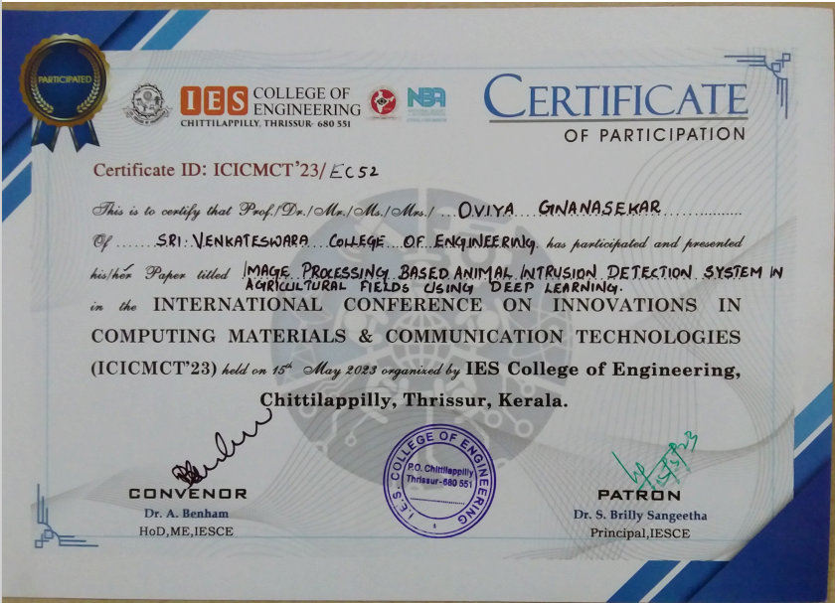
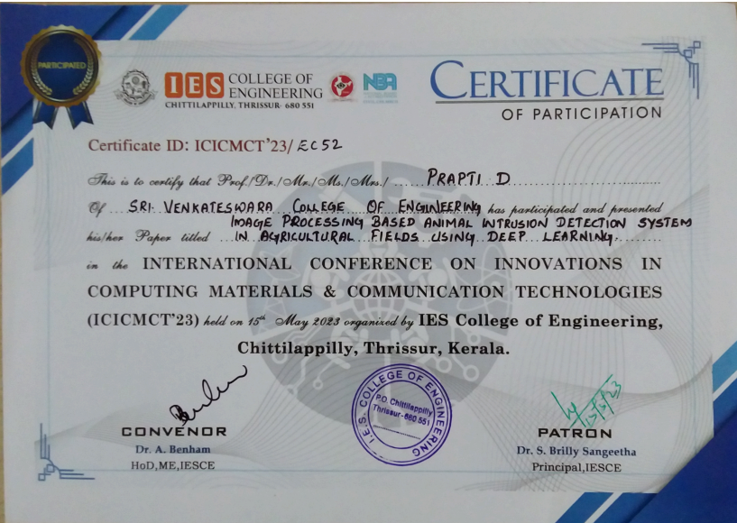

Slide 35
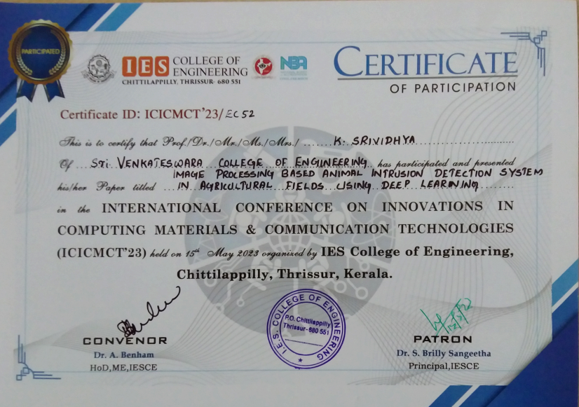

Slide 36
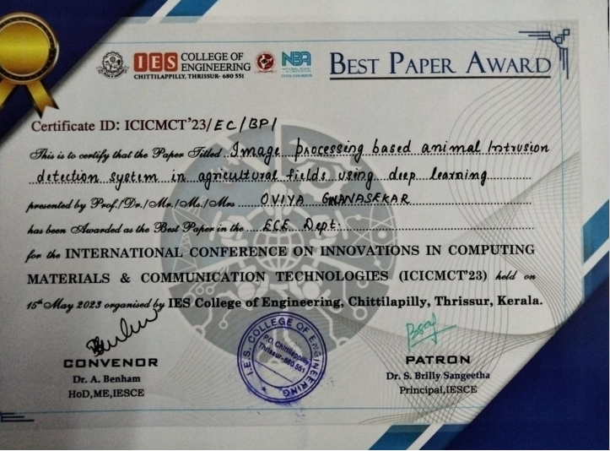
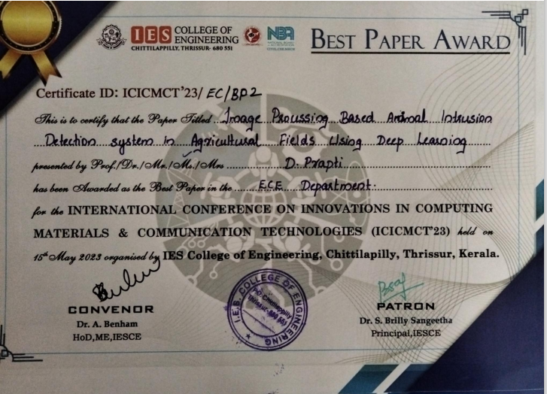

Slide 37
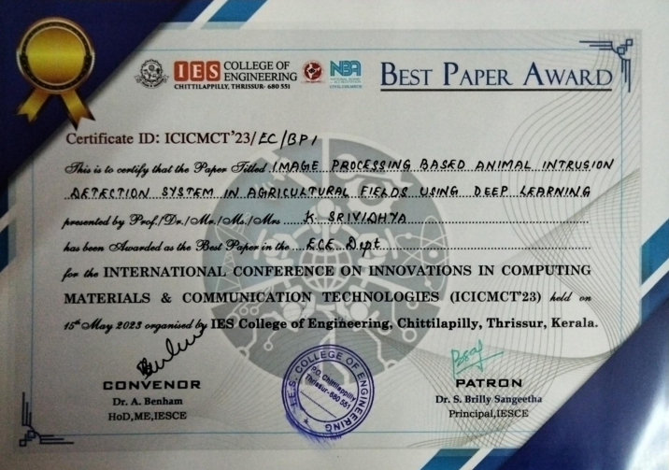

Slide 38
THANK YOU

